Slide 1
Gene Classification
Lab presentation

Slide 2
Gene categories
Tissue specific
genes

Slide 3
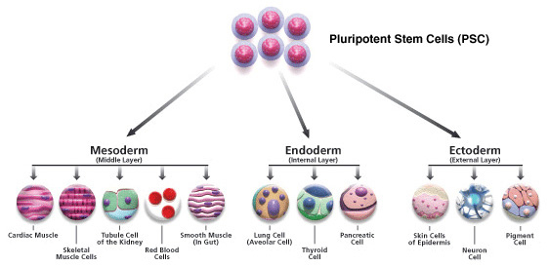
Tissue tree

Slide 4
Outline
Data
Biclustering (nsNMF)
Enrichment analysis
Tree biclustering generative model

Slide 5
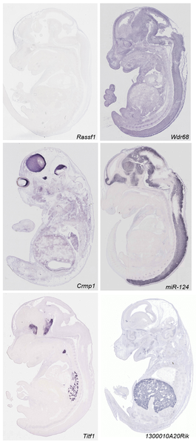
In-situ hybridization data
Diez-Roux G, Banfi S, Sultan M, Geffers L, et al. (2011) A High-Resolution Anatomical Atlas of the Transcriptome in the Mouse Embryo. PLoS Biol 9(1): e1000582. doi:10.1371/journal.pbio.1000582
http://www.plosbiology.org/article/info:doi/10.1371/journal.pbio.1000582
Notes:
Mouse transciptomic data. They have analyzed around 18000 transcript by RNA ISH. They performed saggital section on 14th day wild type mice.

Slide 6
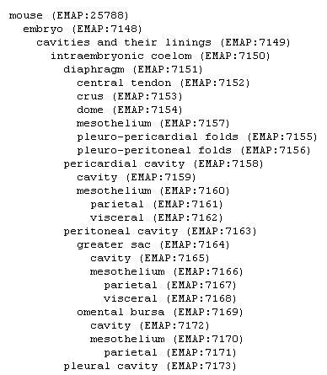
ISH data
RNA ISH for each 18000 transcripts
Automatic microscopes collect image data
Sent out in a digital format for Manual annotation across the tissue tree
Notes:
Discretized data matrix have information whether a particular gene have high low medium or no expression in this 811 anatomies

Slide 7
ISH data
360,000 images were viewed and annotated!
5510 genes x 811 anatomies matrix
11000 genes x 811 tissue matrix with missing data.
Discrete data with annotation strong, medium, weak or no expression
Notes:
Discretized data matrix have information whether a particular gene have high low medium or no expression in this 811 anatomies

Slide 8
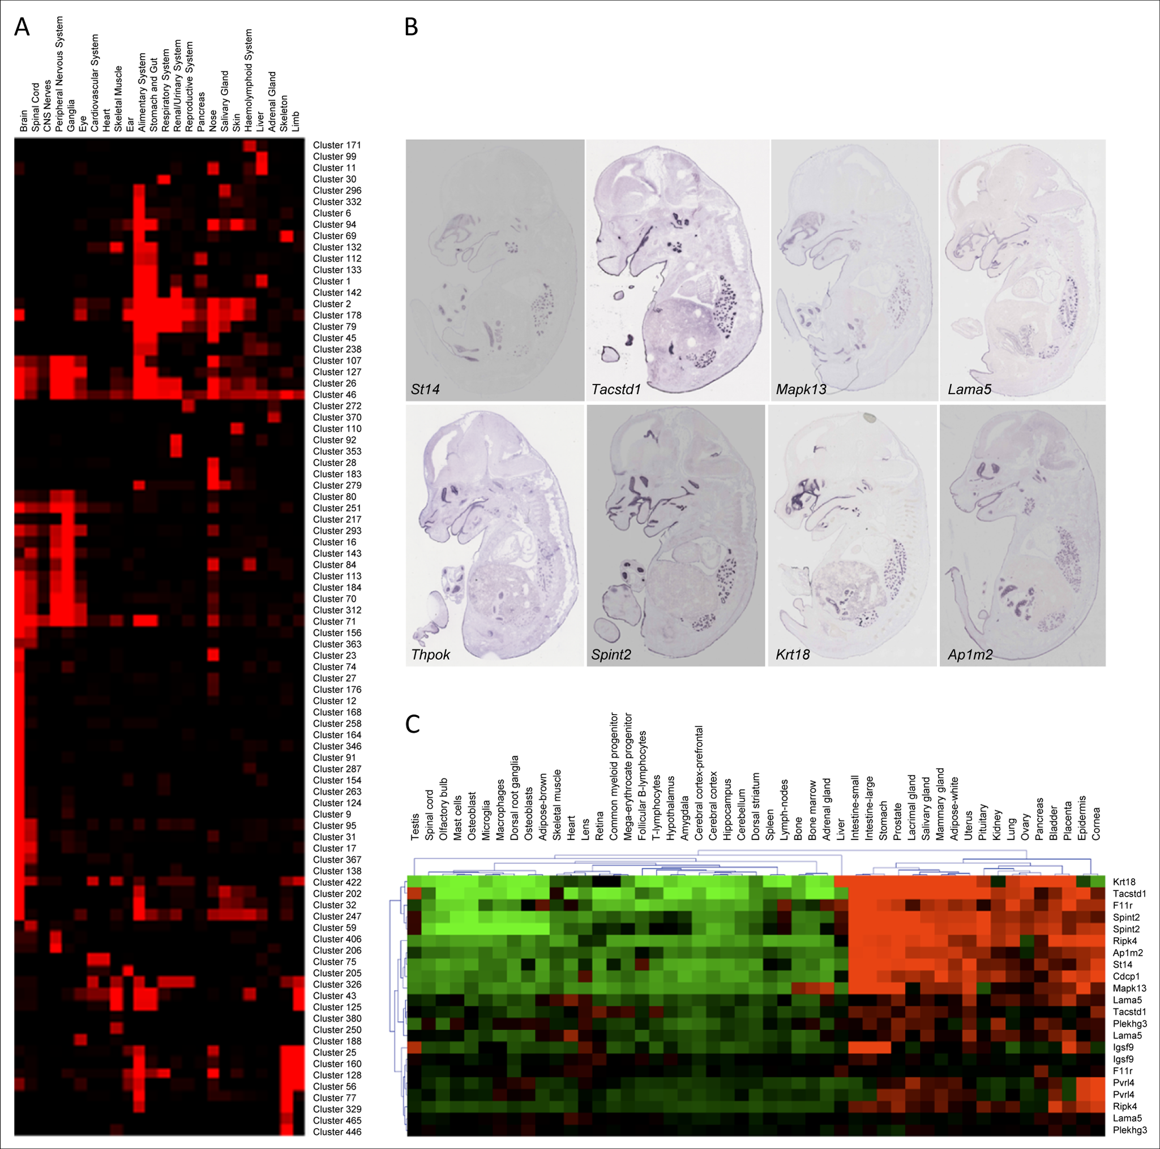
Spatial gene-expression
3D space ⬄ Tissue tree⬄ Gene expression`
Gene expression matrix

Slide 9
Spatial gene-expression

Slide 10
Spatial gene-expression
3D space ⬄ Tissue tree⬄ Gene expression

Slide 11
Spatial epigenetic
Build a map of epigenetic data along the tissue
Chip-Seq experiment for each tissue types?
3D space ⬄ Tissue type ⬄ Gene expression
⬄ Epigenetics data
Motif enrichment
….

Slide 12
Spatial epigentics
3D space ⬄ Tissue type ⬄ Gene expression ⬄ Epigenetics data
Motif enrichment
….

Slide 13
Tissue type ⬄ Gene expression
Clustering
Group of rows having similar expression across all tissues
Gene multifunctional
➔ Group of gene display similar expression across some tissue

Slide 14
Tissue type ⬄ Gene expression
Gene expression matrix

Slide 15
Tissue type ⬄ Gene expression
Biclustering:
Statistically significant correlated sub-martices
Direct map of tissue to gene
Overlapping biclusters ➔ multifunctional gene
Not cover all matrix ➔ remove uninteresting genes

Slide 16
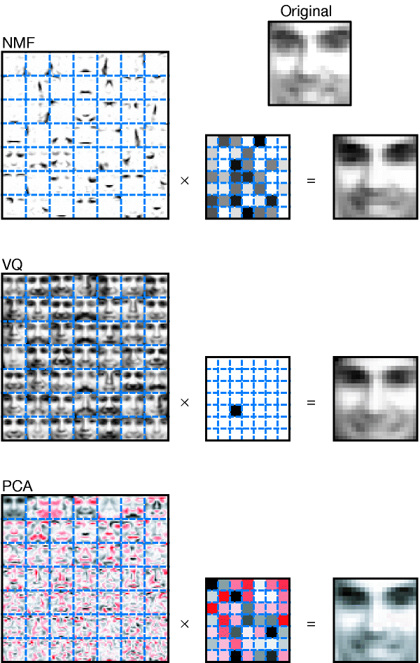
Non-negative matrix factorization
Lee DD, Seung HS: Learning the parts of objects by non-negative matrix factorization. Nature 1999, 401:788-79

Slide 17
Problem with VQ
Only one semantic variable to represent the element.

Slide 18
Problem with PCA
Negative values allowed
All elements are used to represent each documents
No interpretation exists.

Slide 19
NMF
The essence of NMF is that the algorithm must choose a small number of features to act as building blocks that can be scaled and added together in various combinations to best reconstruct the original data.

Slide 20
NMF

Slide 21
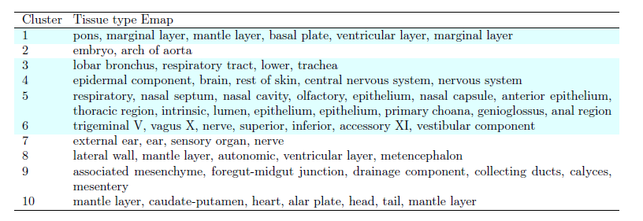
Tissue specific biclusters

Slide 22
Bi-Clustering
Cheng-Church Algorithm
Bicluster are constant up to row and column effect
Residue is deviation from this
Greedy search
SAMBA
Bipartite graph
Biclusters are dense subgraph
Null hypothesis: random graph
Alternative hypothesis: edges in bicluster appear with high probability
Notes:
CC: expression levels in a bicluster are constant up to row and column (additive) effects, deviation from this is defined as residue. Greedily search submatrix.
SAMBA: Statistical-Algorithmic Method for Biclustering Analysis. Bipartite graph.

Slide 23
Bi-Clustering
Bimax
Concentrate ones in the upper right
Divide in 2 submatrices
Notes:
CC: expression levels in a bicluster are constant up to row and column (additive) effects, deviation from this is defined as residue. Greedily search submatrix.
SAMBA: Statistical-Algorithmic Method for Biclustering Analysis. Bipartite graph.

Slide 24
Grid search
Best biclustering methods
Bi-clustering algorithm?
Number of biclusters?
Parameter of biclusters?

Slide 25
Grid search
Grid search with GO enrichment score
Percentage of significant biclusters
Percentage of GO annotation enriched

Slide 26
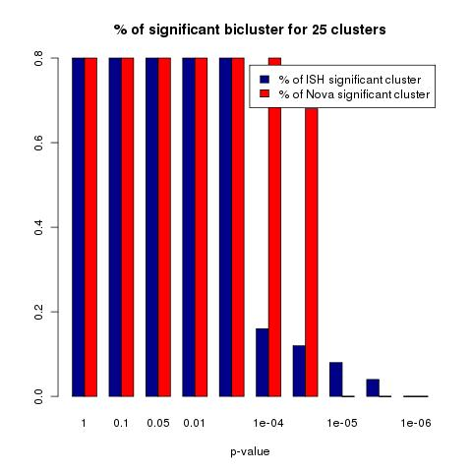
Comparison with novartis dataset
21000 genes x 122 tissue types

Slide 27
Enrichment analysis
Enrichment analysis with:
Chromatin (Different cell types)
DNase
CPG
Enhancer
Methylation
TFBS
….

Slide 28
Enrichment analysis
Biclusters
with specific cell type activity
siginificant enrichment of transcription factors and chromatin signatures

Slide 29

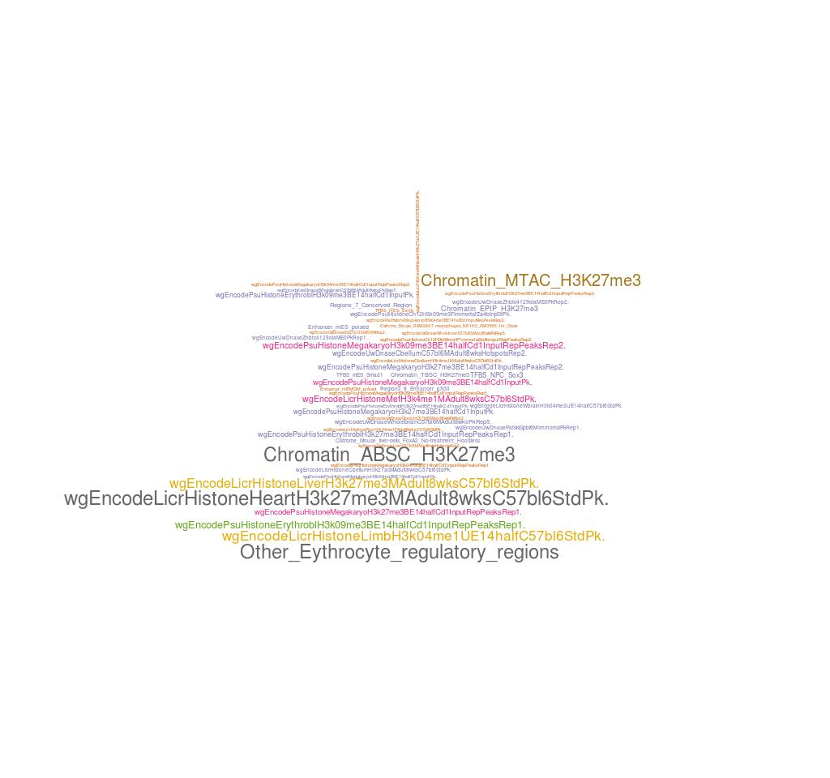
Epigenetic enrichment
Cluster 1
Cluster 2

Slide 30
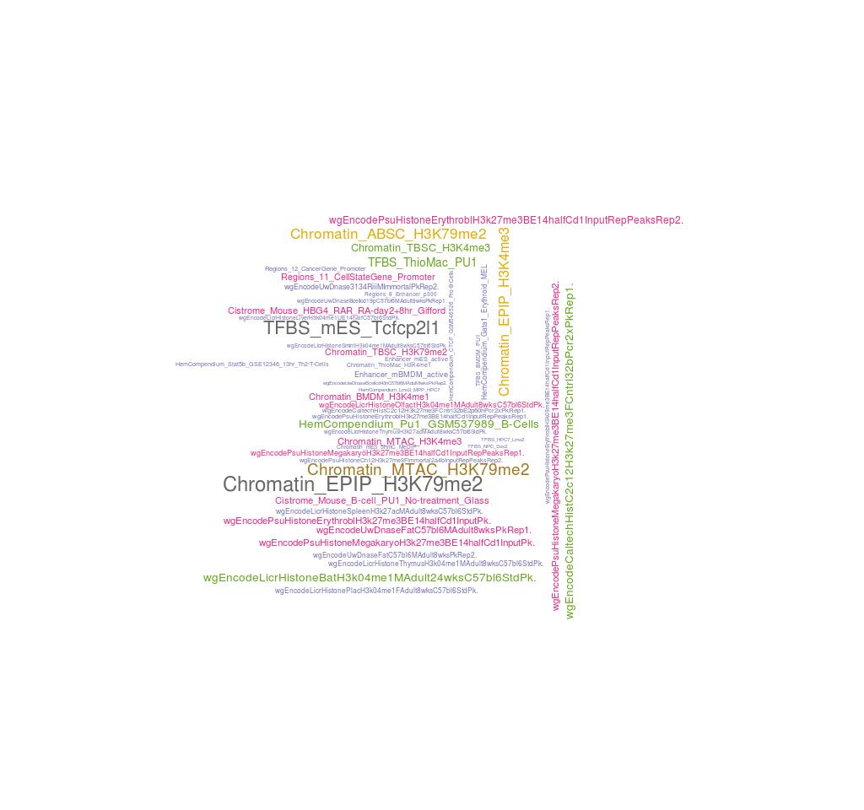
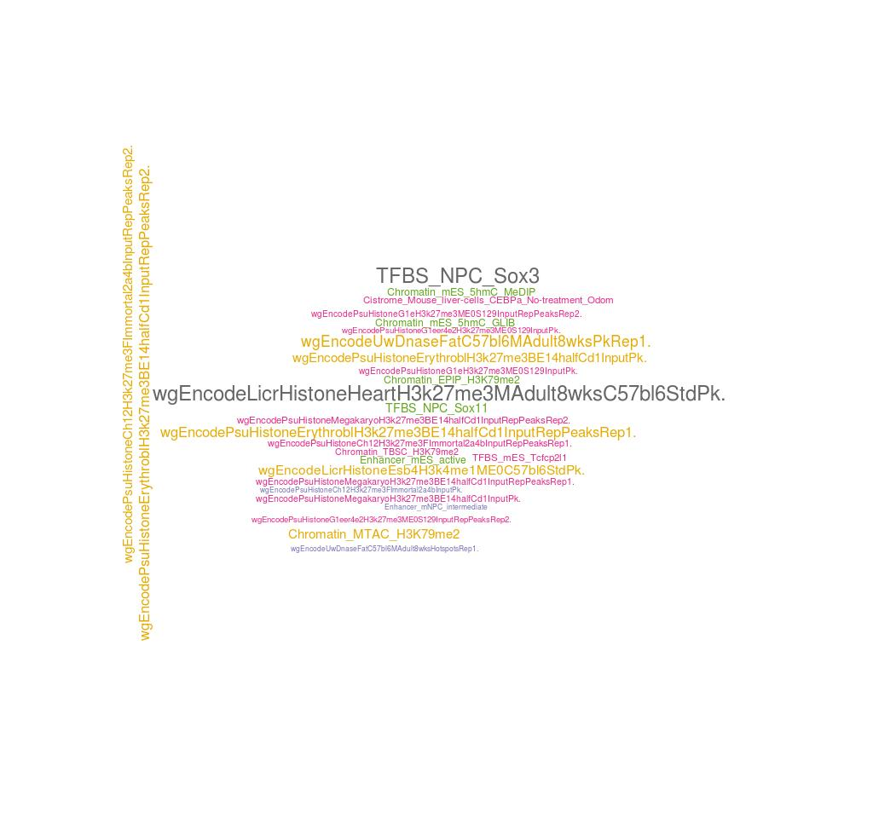
Epigenetic enrichment
Cluster 4
Cluster 5

Slide 31
Motif enrichment
GC bias compensated foreground and background
Score TRANFAC vertebrate motifs
Fisher exact test

Slide 32
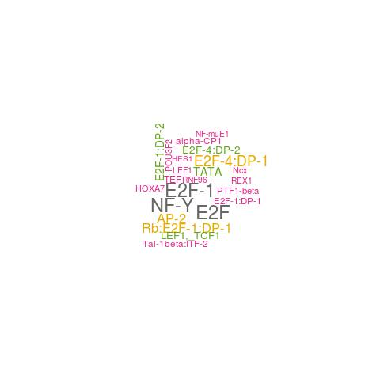
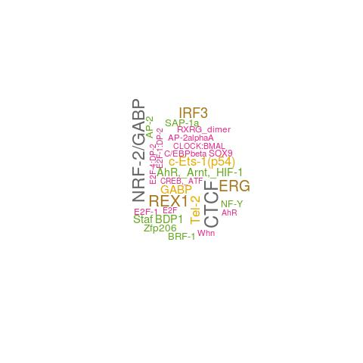
Motif enrichment

Slide 33
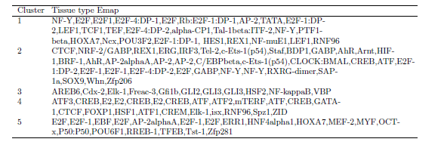
Motif enrichment

Slide 34
Spatial epigenetic map
Tissue ⬄ Signature genes
⬄ Signature epigenetic factors
⬄ Signature motifs

Slide 35
Tissue specific biclusters

Slide 36
Problem with traditional biclustering
Deeply overlapping biclusters
Prior information about the gene or tissue structure cannot be used
We have a tissue tree
No distinction between active or inactive gene in biclusters
Discrete data

Slide 37
Tissue tree biclustering
We already have tissue tree
Discrete data
Want to differentiate active and inactive biclusters
Handle missing data and noisy data

Slide 38
Generative model for TISSUE tree biclustering

Slide 39
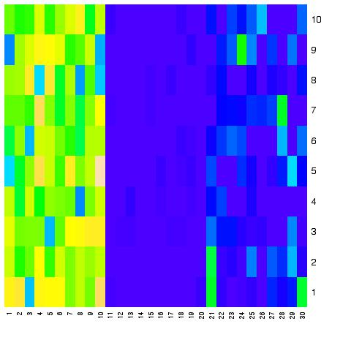
Latent gene state variable
z_{g,heart} = 0 homogenously inactive
in subtree
Embryo
brain
Forebrain
Hidbrain
limb
Forelimb
Hidlimb
heart
z_{g,brain} = 2 inhomogenously subtree
z_{g,limb} = 1 homogenously active
in subtree

Slide 40
Latent gene state variable
Latent gene state variable of subtree for each gene at each node
z_{g,n} = 0 ➔ Gene exp is homogenously inactive in subtree
z_{g,n} = 1 ➔ Gene exp is homogenously active in subtree
z_{g,n} = 2 ➔ Gene exp is inhomogenous in subtree

Slide 41
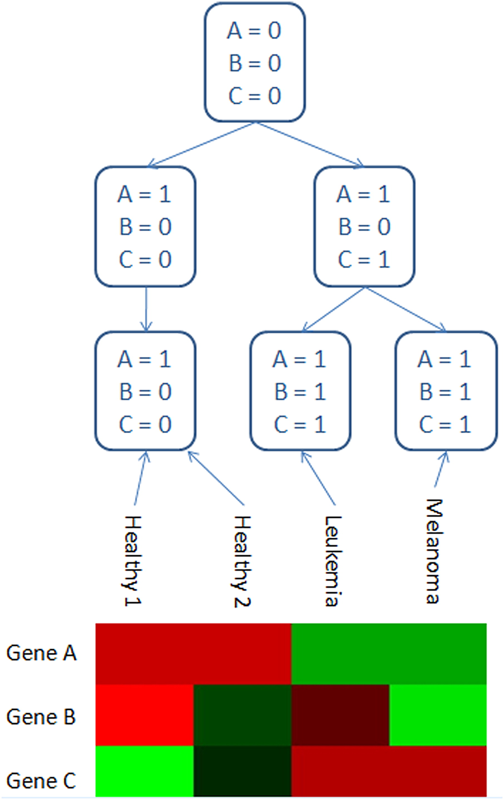
Generative biclustering
forelimb
Hindlimb
Hindbrain
Forebrain

Slide 42
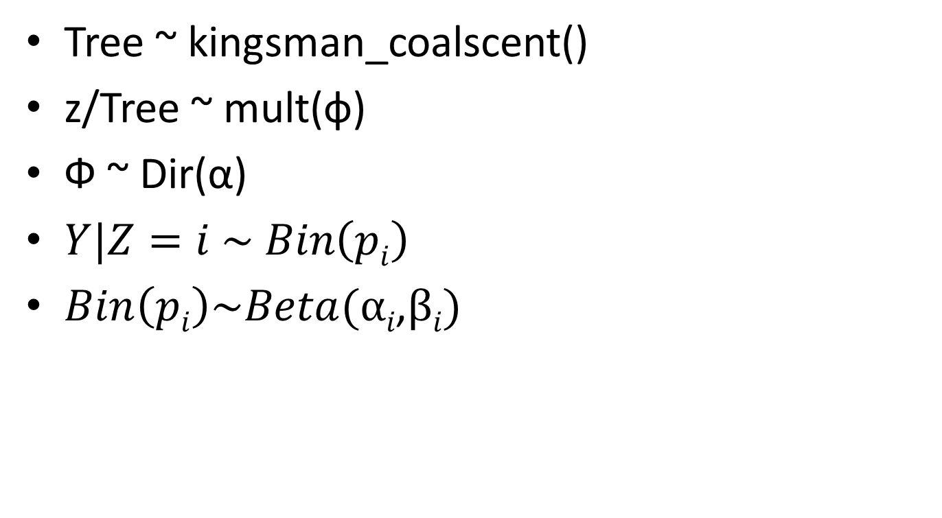
Generative process
Tree ~ kingsman_coalscent()
z/Tree ~ mult(ф)
Ф ~ Dir(α)
$Y|Z=i \sim Bin\left(pi\right)$
$Bin\left(pi\right)\sim Beta(αi\text{,} βi)$

Slide 43
Kingsman’s coalescent

Slide 44
Kingsman’s coalescent

Slide 45
Kingsman’s coalescent

Slide 46
Kingsman’s coalescent

Slide 47
Kingsman’s coalescent

Slide 48
Data generation: Forward sampling

Slide 49
Inference: Upward propogation

Slide 50
Inference: Integrating out

Slide 51
Latent gene state variable
A=2
B=2
C=2
A=0
B=1
C=2
A=0
B=1
C=0
A=0
B=1
C=2
Like HMM

Slide 52
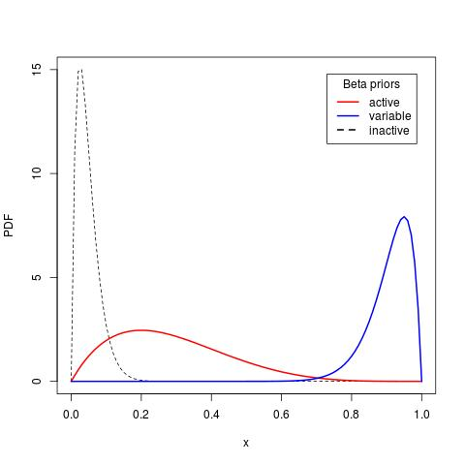
Generative process

Slide 53
Advantage
Missing data handling
Tissue tree specific biclustering
Active and inactive biclusters
Error resistant
Assign edge length to tissue tree

Slide 54
Conclusion
Biclustering of ISH data
Enrichment analysis of biclusters
Tissue tree specific biclustering

Slide 55
Thanks

